Slide 1
Assessment of Northwind Traders

Slide 2
Purpose Methods
Assess the health of business logistics/practices
Determine avenues for increased revenue and decreased cost
Sample 830 orders over a two year period
Strict definition of parametric data
Multiple non-parametric tests to account for decreased robustness
Notes:
The aim of this project was to evaluate the overall health of the Northwind Traders company. This was achieved by analyzing their business practices and logistics on several fronts: The effect discounts have on customer spending habits; The purchasing trends of specific customer contact types; Evaluating the performance of the three shipping companies on contract; and Examining employee sales numbers. The specific goal of each analysis was to elucidate trends that could be used to streamline company practices and drive revenue.
The data used during this project came from a sample of 830 customer purchasing orders between 7/4/2012 and 5/6/2014. These were analyzed for trends and significance via statistical hypothesis testing and the appropriate tests for each analysis were selected based on a strict definition of parametric data. The term parametric , and its opposite non-parametric, simply refers to the shape of the data distribution; whereby parametric data resemble the shape of a bell with the majority of the values clustering around the average value of the sample and non-parametric data resemble shapes that deviate from this normal bell curve. This decision was made to ensure the assumptions of each test were satisfied, thereby adding confidence to the actual significance of each result. Additionally, because this decision to strictly adhere to the assumptions for parametric testing eliminated the use of some of the more robust statistical tests, each test was triple checked by three different non-parametric methods: the Kolmogorov-Smirnov test, the Mann-Whitney U test, and the Kruskal-Wallis test.

Slide 3
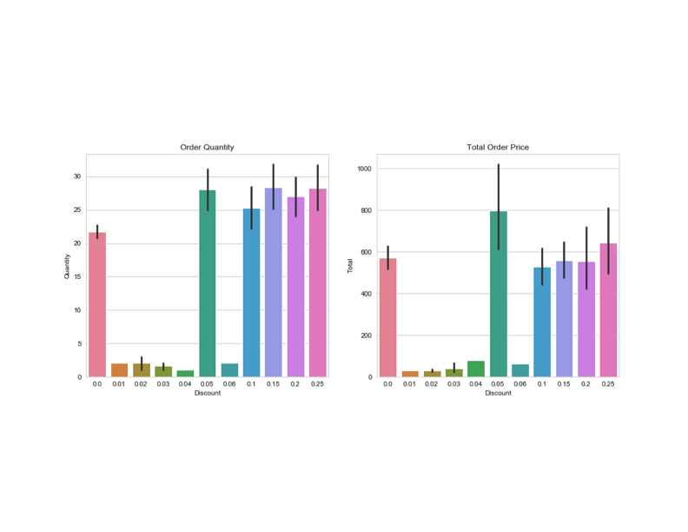
Effect of Discounts on Order Quantity and Total Price
No discount
Notes:
The initial task of this project was to determine if discounts effect order quantity, and if they do effect order quantity, at what level of discount is this effect seen. The chart on the left of the screen displays the average quantity of orders at the various levels of applied discounts. The average quantity of non-discounted orders is represented by the pink bar on the far left of the chart. Statistical testing suggests that discounted orders have significantly higher quantities than non-discounted orders and that 25% discounts have the greatest effect on increasing order quantity over non-discounted orders.
The chart on the right of the screen displays the average total of orders at the various levels of applied discounts. Again, the pink bar on the far left of the chart represents non-discounted orders. Statistical testing suggests that discounted orders have significantly higher order totals than non-discounted orders and that the 5% discount level (which includes discounts between 1% and 5%) has the strongest effect on increasing order totals over non-discounted orders.
From these results it can be suggested that if the directive of the use of discounts is to move larger quantities of products, 25% discounts should be offered to the customer. And if the directive of the discounts is to encourage increased customer spending, then 5% discounts should be offered. It is also important to note than 25% discounts had the second strongest effect on increasing order totals over non-discounted orders. Thus, both directives could be accomplished with the 25% discount.

Slide 4
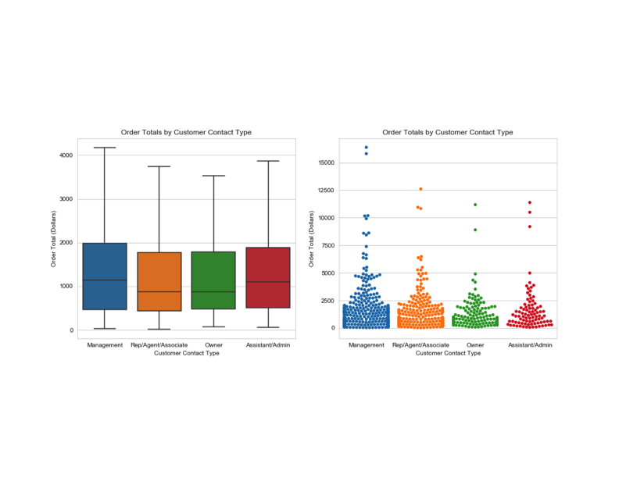
Effect of Customer Contact Type on Order Total
Notes:
The next area of evaluation was to determine if different customer contact types within the corporate hierarchy spend more on orders than others. The aim of this analysis is to help Northwind Traders target specific contacts within prospective customer companies that statistically have higher purchase order totals. The 12 customer contact titles in the sample were grouped based on their corporate level to form four groups: Owners, Management, Representative and Agents, and Assistants and Admins. The chart on the left displays the distribution of order totals for each contact group: Owners are shown in green; management is in blue; reps and agents are in orange, and assistants and admins are in red. The black line running through the middle of each box represents the average order total for that group. The extreme values in the sample were removed from the chart on the left to improve the detail of the information displayed. The chart on the right includes these extreme values and demonstrates that while most orders fall below a total of $2500, there is considerable spread for each group beyond $2500.
Pairwise statistical testing between the contact types found no significant difference in their purchasing order totals. These results suggest that simply establishing contact with a prospective customer, regardless of their title, can lead to potential sales and that no additional resources need to be directed towards targeting specific people within a prospective client company.

Slide 5
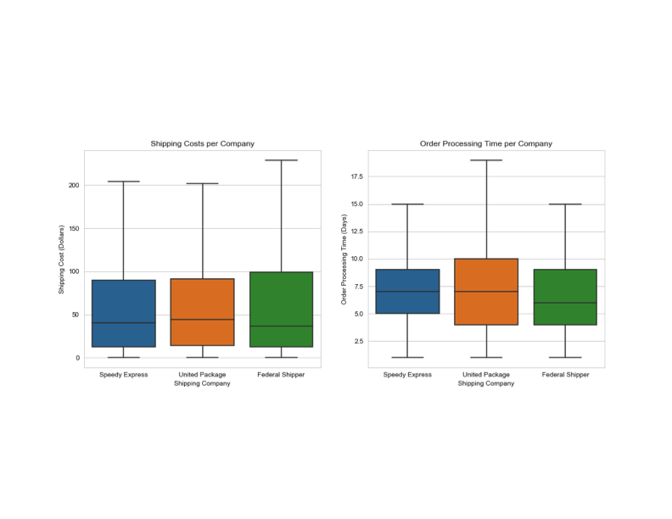
Analysis of Shipping Companies
*
Notes:
Now, reaching out to a customer and finalizing a purchase is great. But, it means nothing if Northwind Traders can’t get the products to their customers. Thus, a thorough analysis of the shipping department was conducted to evaluate the costs and performance of the three shipping companies on contract. The chart on the left of the screen displays the distribution of shipping costs, where Speedy Express is in blue, United Package is in orange, and Federal Shipper is in green. Again, the black bar running through each box represents the average shipping costs for each company. The chart on the right displays the distribution of order processing times for each company. While there was no significant difference found between the shipping costs of the three companies, Federal Shipper had significantly shorter order processing times than the other two companies. Additionally, there were no significant differences in the processing times based on shipment size. Thus, if speed of delivery is the primary concern, Federal Shipper should be selected as the exclusive shipping company as it has significantly shorter processing times and does not differ significantly in terms of cost with the other two companies.

Slide 6
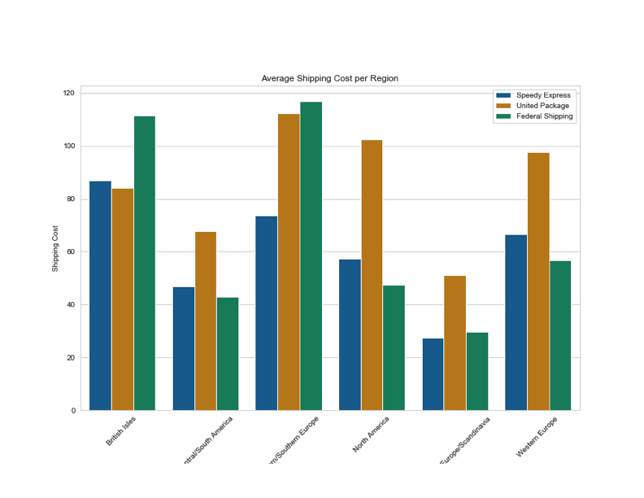
Analysis of Shipping Companies
Notes:
However, when shipping costs were evaluated by delivery region, Federal Shipper had the greatest number of significant cost differences between the regional comparisons and United Package had the fewest number of significant cost differences. Therefore, if annual shipping costs are difficult to predict (and therefore budget appropriately) while utilizing three companies, Northwind Traders should consider using United Package exclusively as their shipping company because its overall shipping costs do not differ significantly from the other two companies and because its regional shipping costs are the most uniform.

Slide 7
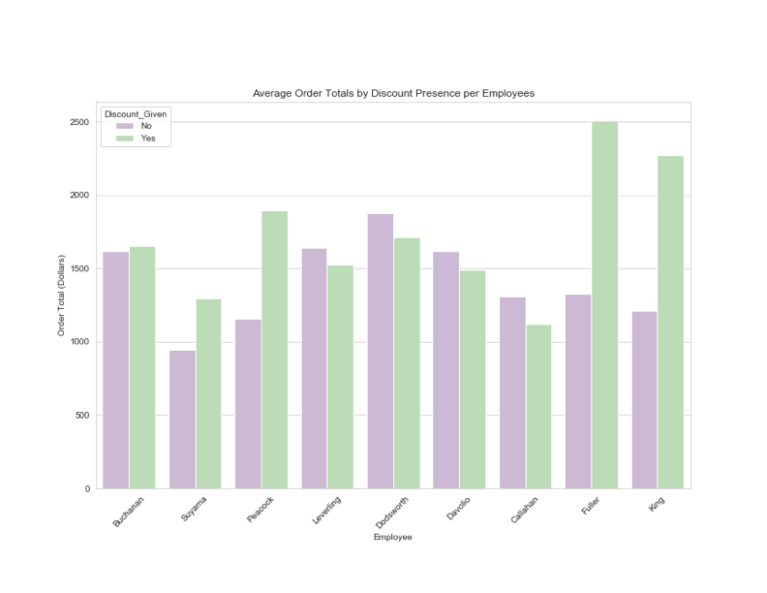
Employee Sales Performance
*
*
*
Notes:
Lastly, the sales performance of the nine employees in the sample were evaluated in an attempt to discover any traits of high-earning employees that could be incorporated into training protocols. Pairwise comparisons of the order totals for each employee were performed and only one employee had significantly different order totals from other employees. The effect of this difference however was relatively small, suggesting that current employee training protocols have provided employees with a relatively equal skills set where no single employee is outperforming the others.
When individual sales techniques were analyzed for each employee, it was found that three employees had significantly higher sales numbers on the orders in which they included discounts over the others where no discount was applied. This result suggests that some employees are able to encourage increased customer spending by offering discounts. Thus, training protocols could be updated to educate employees on the strategic use of discounts to increase customer spending.

Slide 8
Business Recommendations
Discounts
Contact types
Shipping
Employee Training Protocols
Notes:
The results from this project produced multiple business recommendations for improving Northwind Traders. First, discounts significantly increase both order quantity and order total. The results suggest offering 25% discounts to increase the quantity of items sold in an order and to offer a 5% discount to increase the order total. Second, because there was no difference found between the order totals of the four customer contact groups, employees should be encouraged to establish whatever contact they can with a respective client and not to focus on the particular position the customer contact holds within their company. Third, because there was no significant difference found between the overall shipping costs of the three companies on contract, Federal Shipper should be considered for most shipments as it had significantly shorter processing times than the other two companies. However, if shipping costs are difficult to budget for using three companies, United Package should be considered as the exclusive shipping company as its regional shipping costs were the most uniform. Lastly, employee training protocols should be updated to educate current and new employees on the effects of discounts found in this project and how discounts can be used strategically to increase sales numbers.

Slide 9
Future Work
Contact Types
Regional shipping costs
Accuracy of shipping companies
Notes:
There were multiple trends identified during the course of this project that should be examined further as their potential to add to the overall health and performance of Northwind Traders is great.

Slide 10
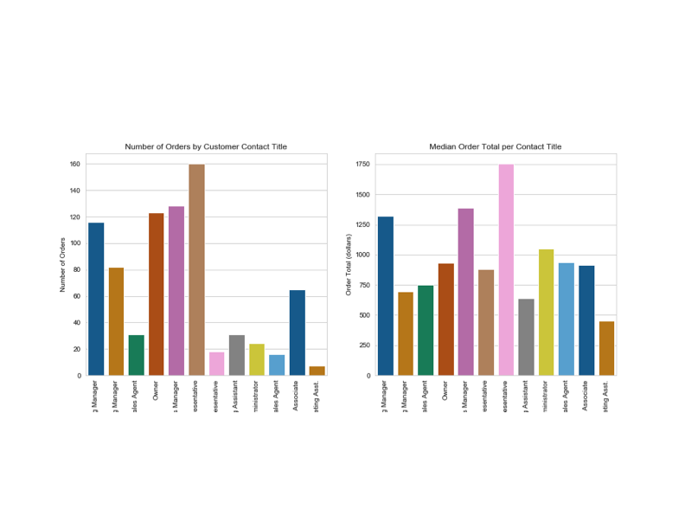
Trends in Spending by Customer Contacts
Notes:
First, there did appear to be significant differences between the spending habits of the customer contact types in the sample. However, these may have been lost by the need to group some of the titles together for statistical testing. For instance, the pink bar in the middle of each chart represents orders placed by Sales Representative. The chart on the left displays the number of orders placed and the chart on the right displays the median order total. While sales representatives placed the second fewest orders, these orders had the highest median total, suggesting sales representative may place larger orders than the other contact types. A larger sample of orders may allow for each title to be evaluated without grouping to determine if this trend is significant.

Slide 11
Determine Performance Metrics of Shipping Companies by Region
Notes:
Next, the regional shipping costs should be compared between the three companies to determine if one company should be used exclusively because of consistently lower shipping costs by region or if shipping responsibilities should be divided by region between the three companies based on whoever has the lowest shipping costs to a particular region.

Slide 12
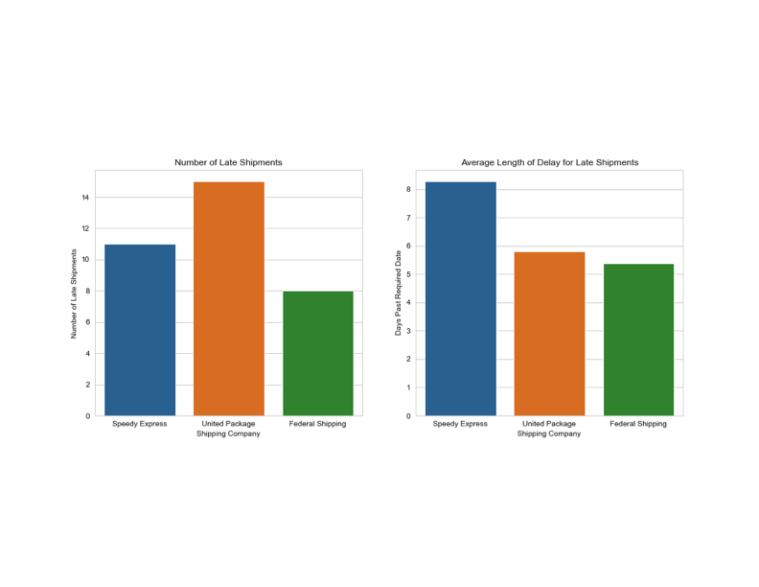
Analysis of Shipping Companies
Notes:
Additional performance metrics should be analyzed for the three shipping companies based on how frequently they fail to ship an order by the required shipment date. Significant differences in shipping company failures should be included to further inform the decision of which company to rely on more heavily in the future.

Slide 13
Thank You
Questions?

